Slide 1

Development Tools and Platforms

Slide 2
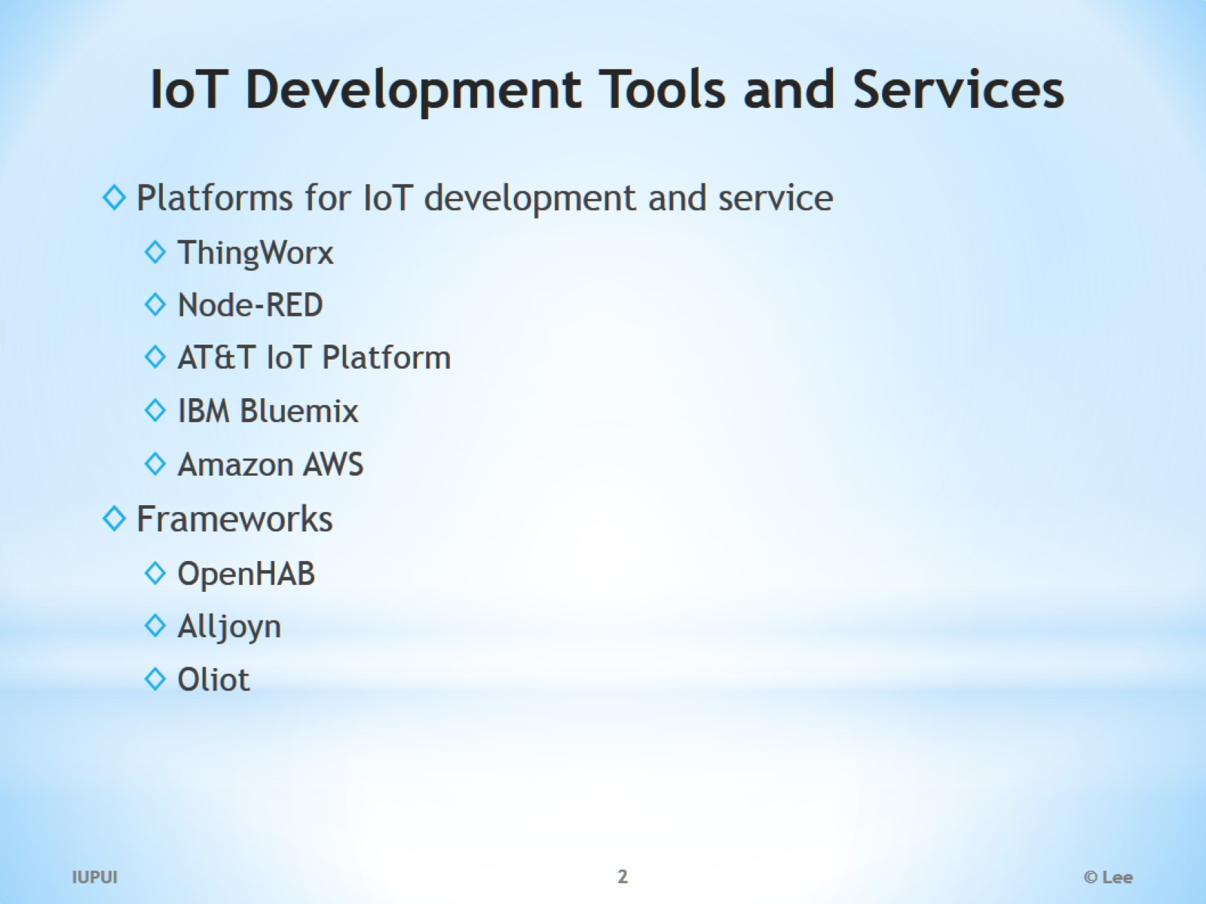
IoT Development Tools and Services

Slide 3
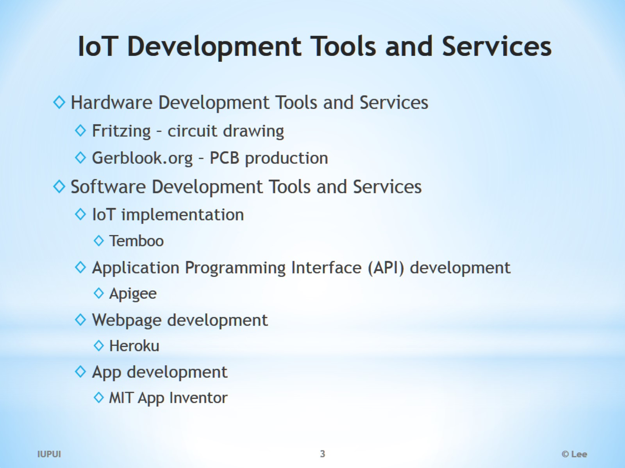
IoT Development Tools and Services

Slide 4
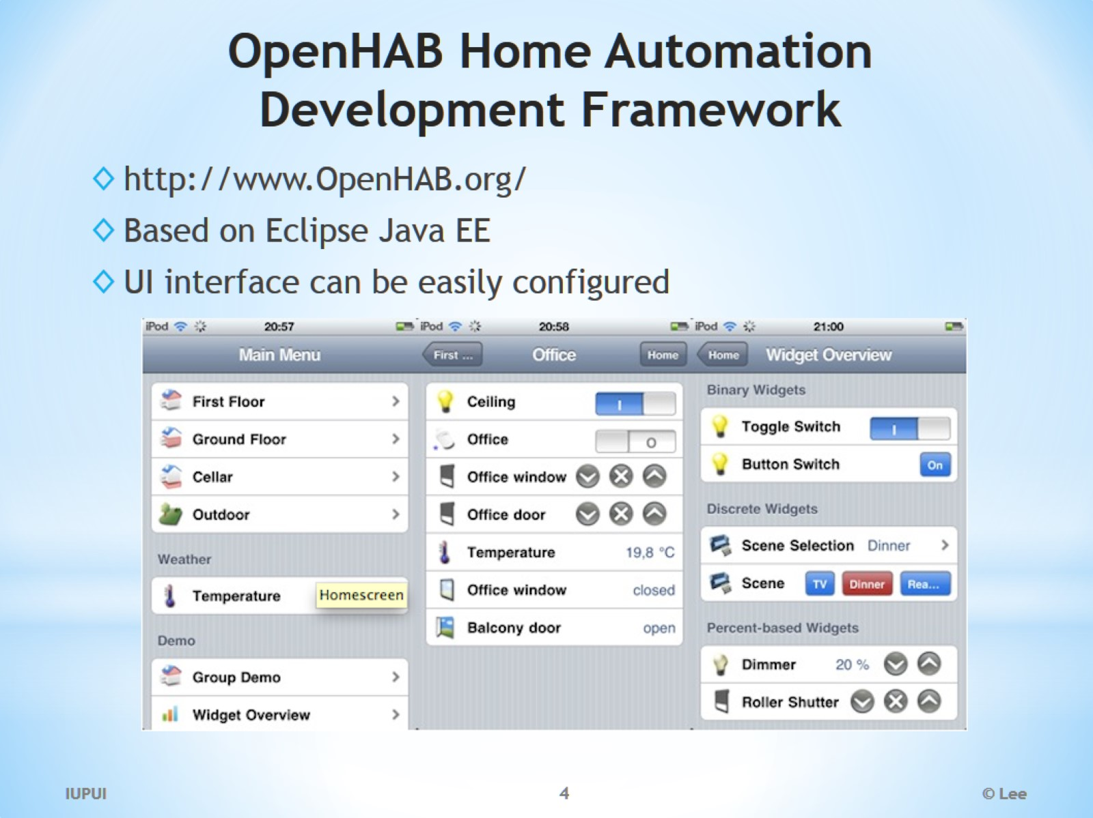
OpenHAB Home Automation Development Framework

Slide 5
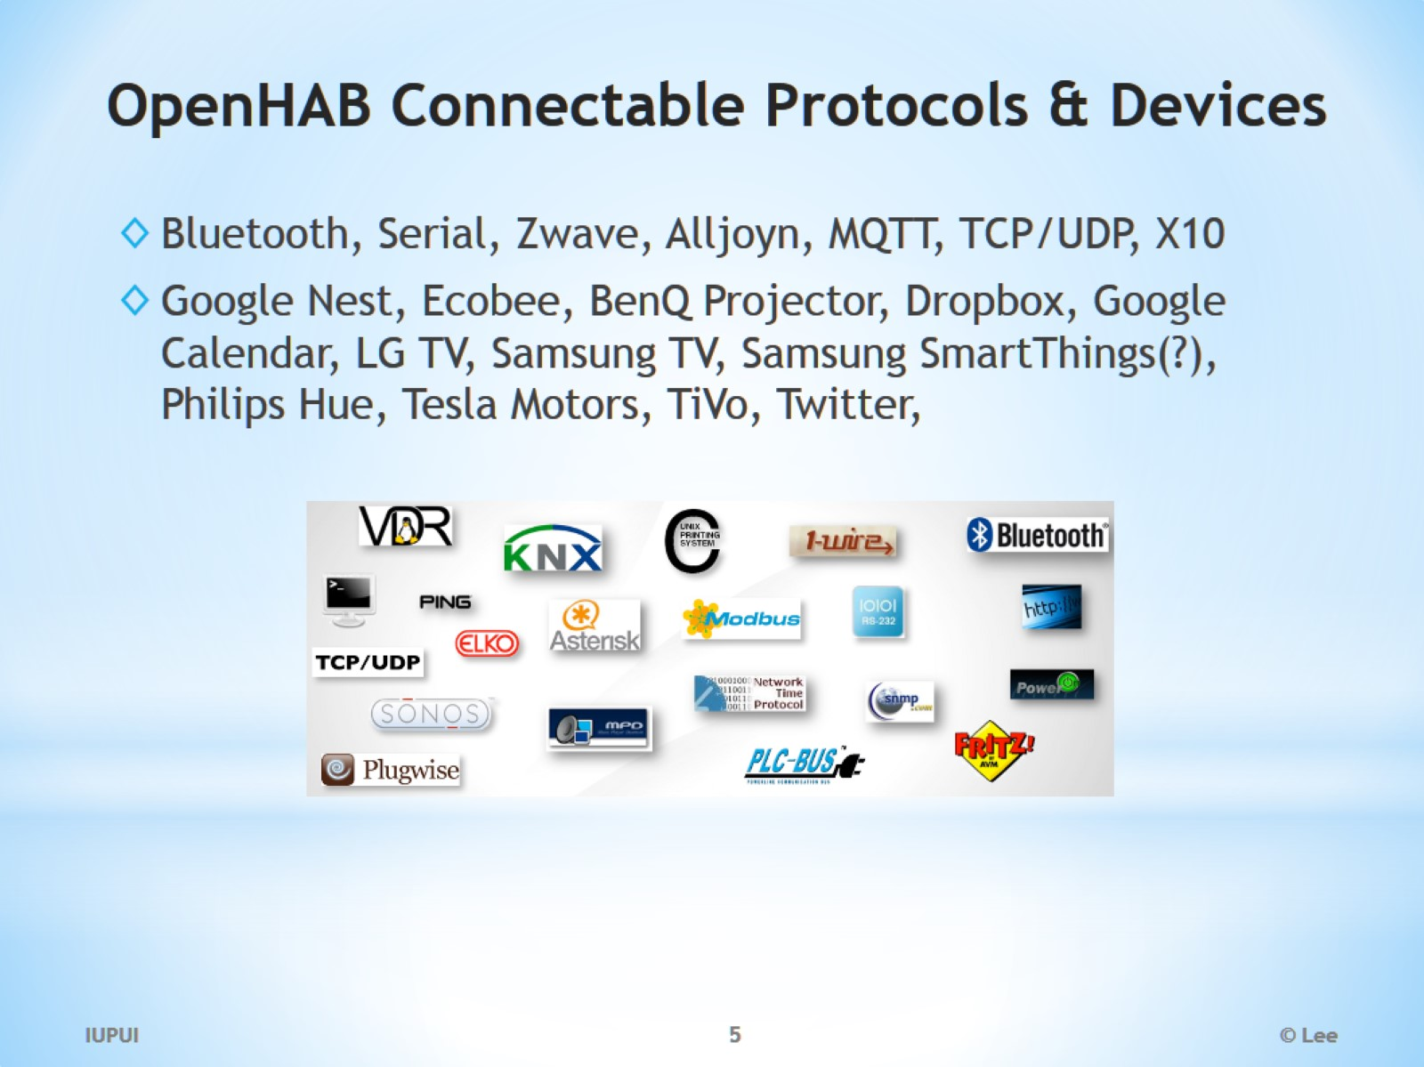
OpenHAB Connectable Protocols & Devices

Slide 6
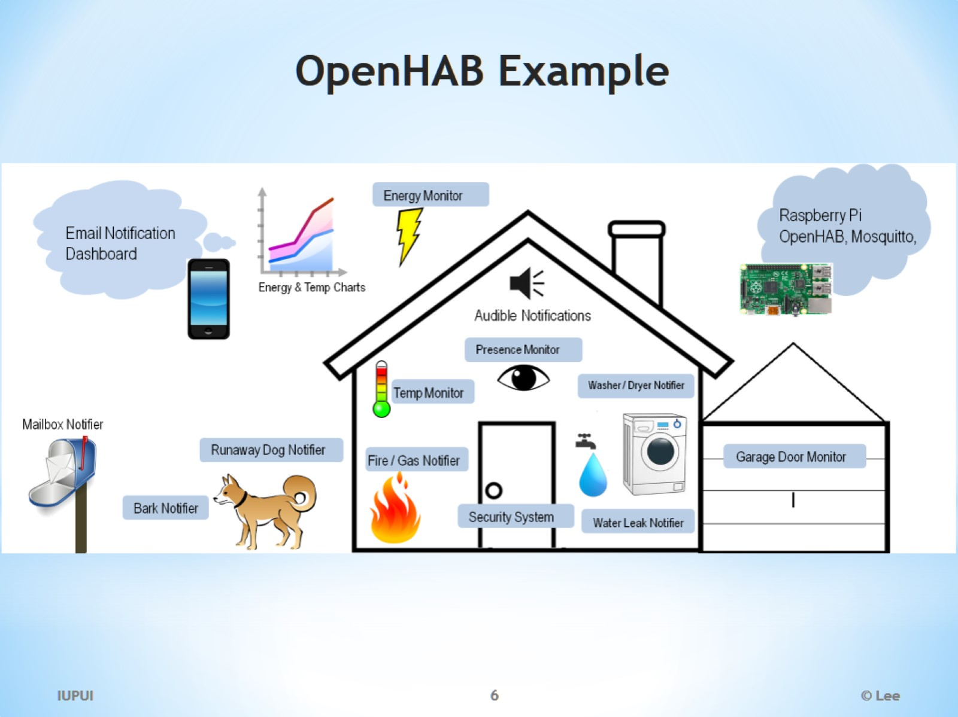
OpenHAB Example

Slide 7
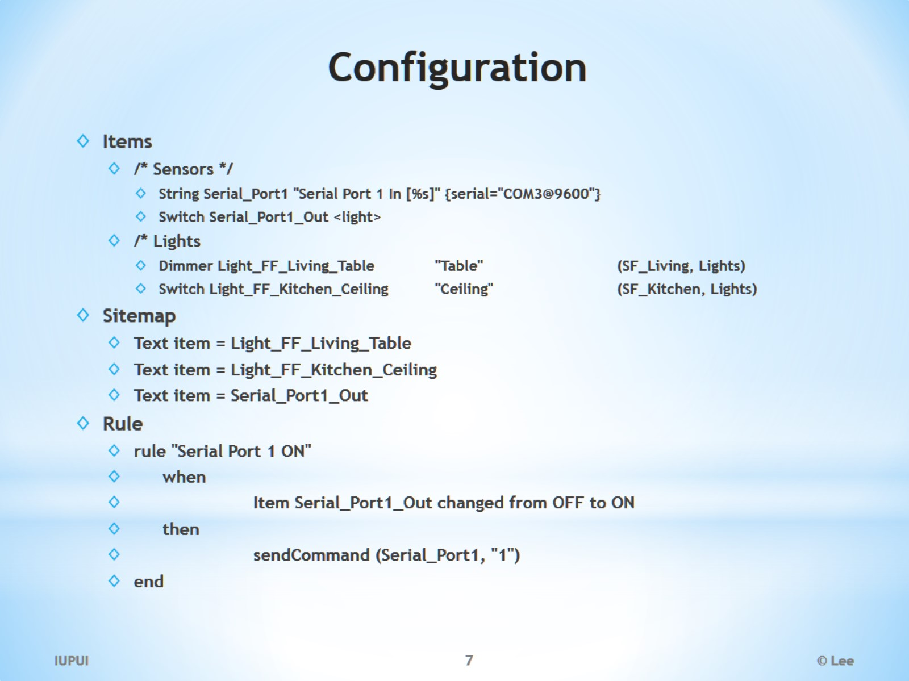
Configuration

Slide 8
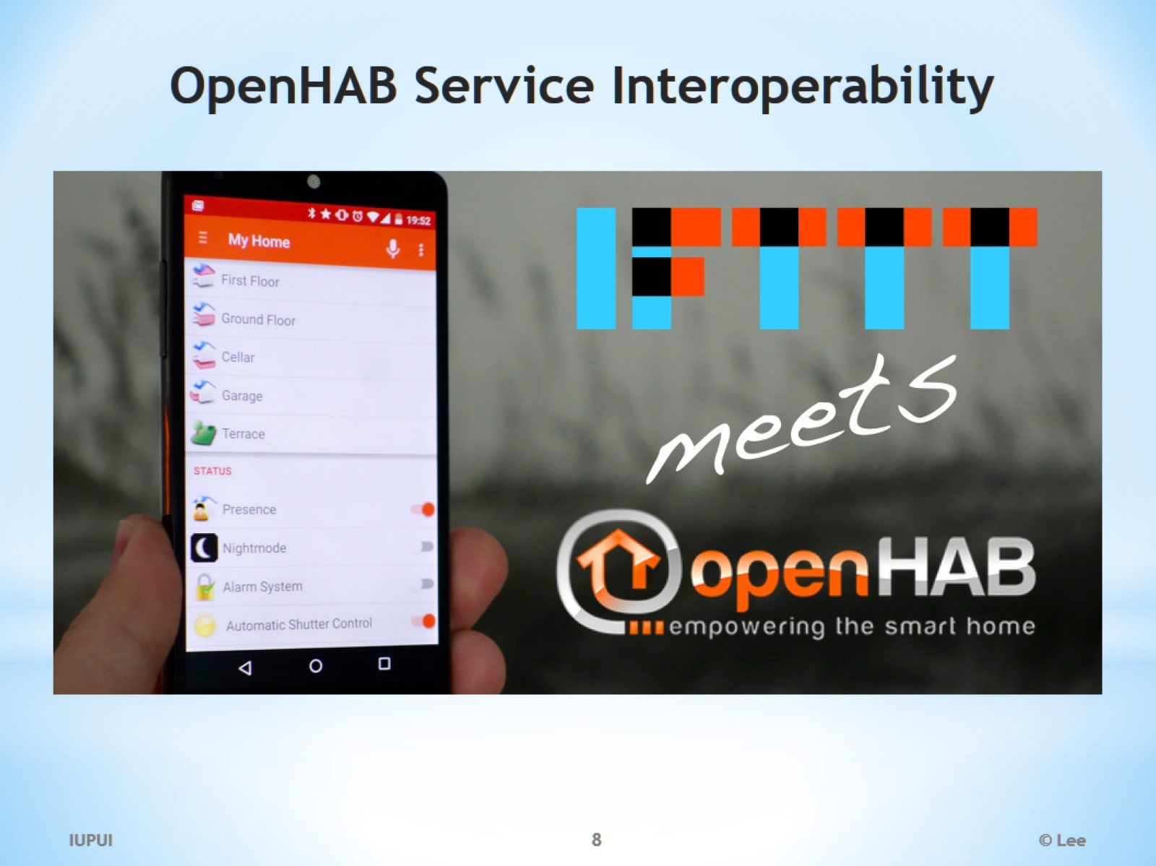
OpenHAB Service Interoperability

Slide 9
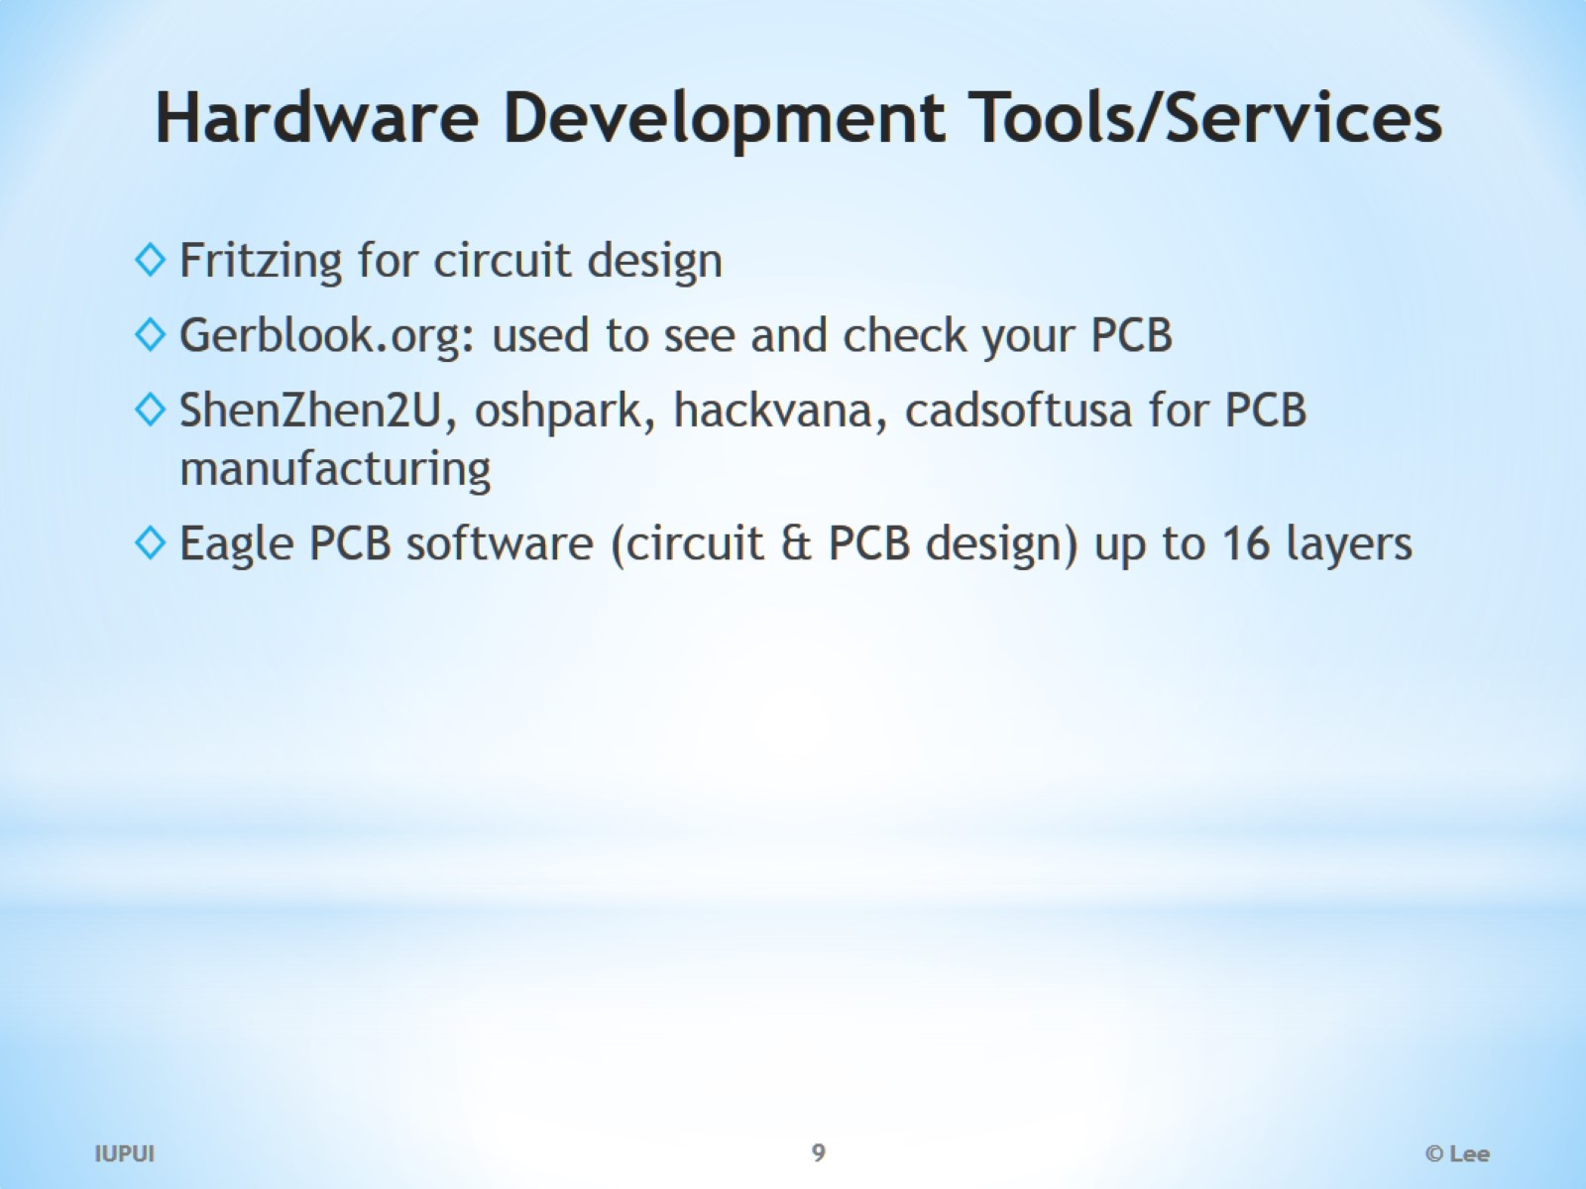
Hardware Development Tools/Services

Slide 10
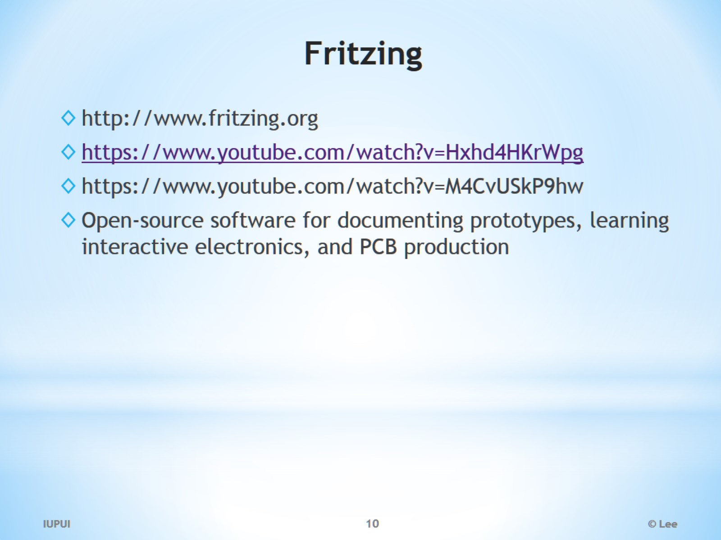
Fritzing

Slide 11
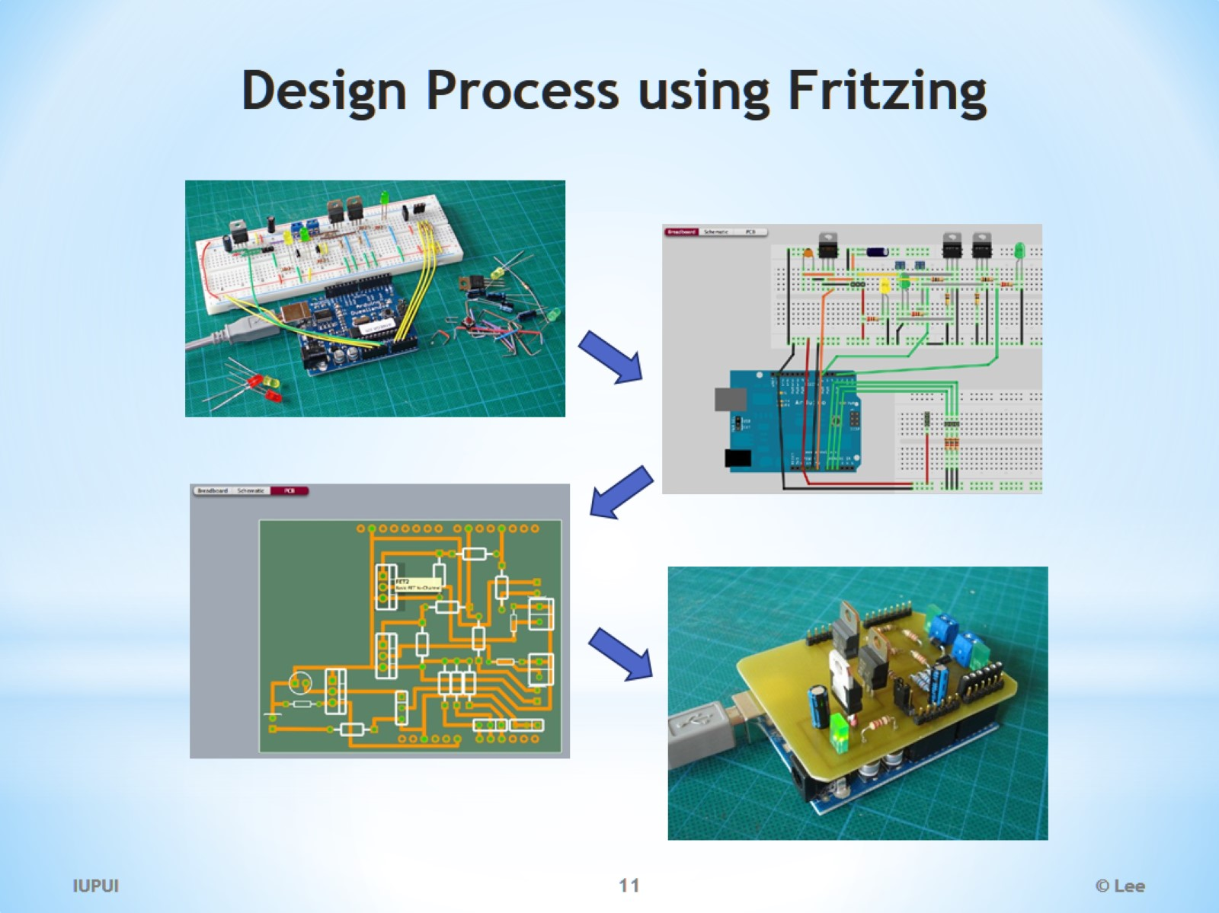
Design Process using Fritzing

Slide 12
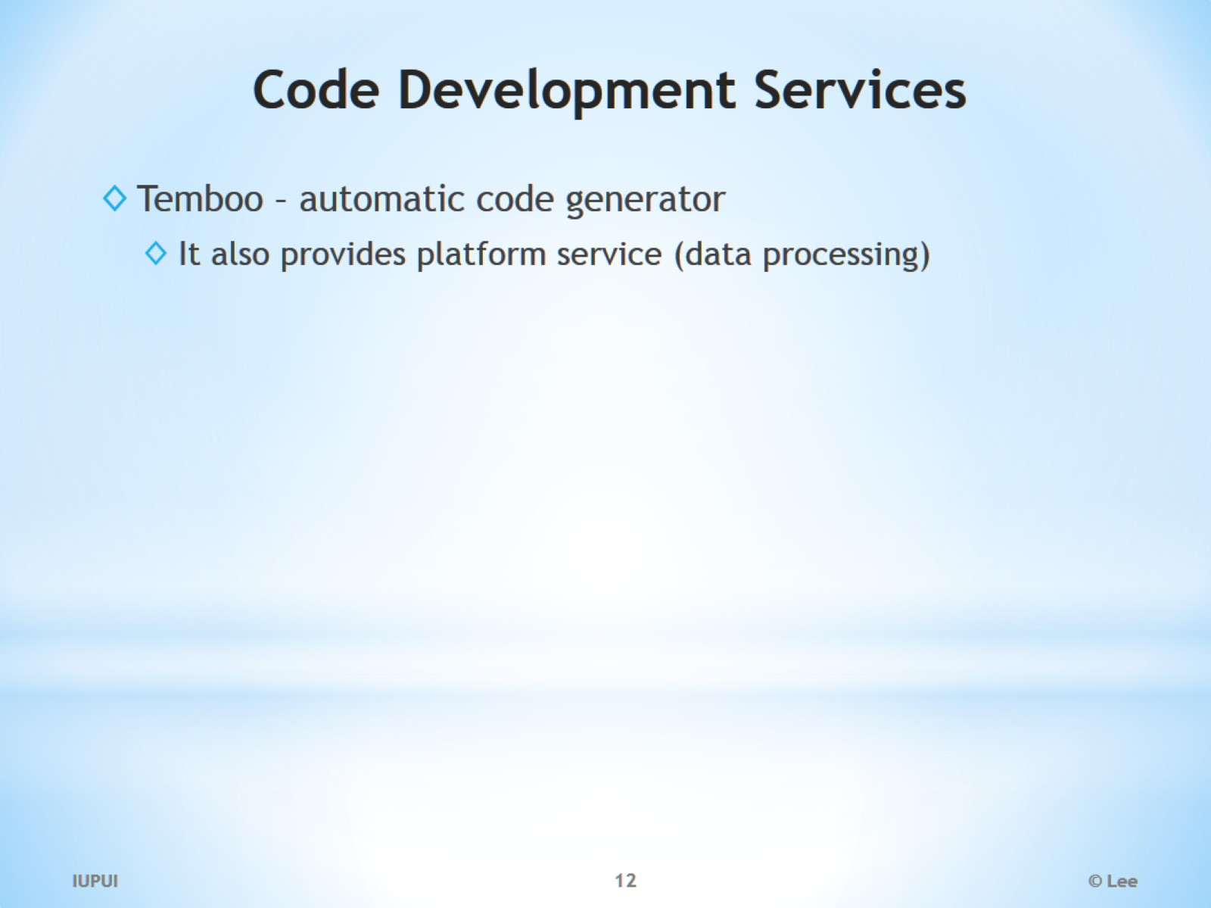
Code Development Services

Slide 13
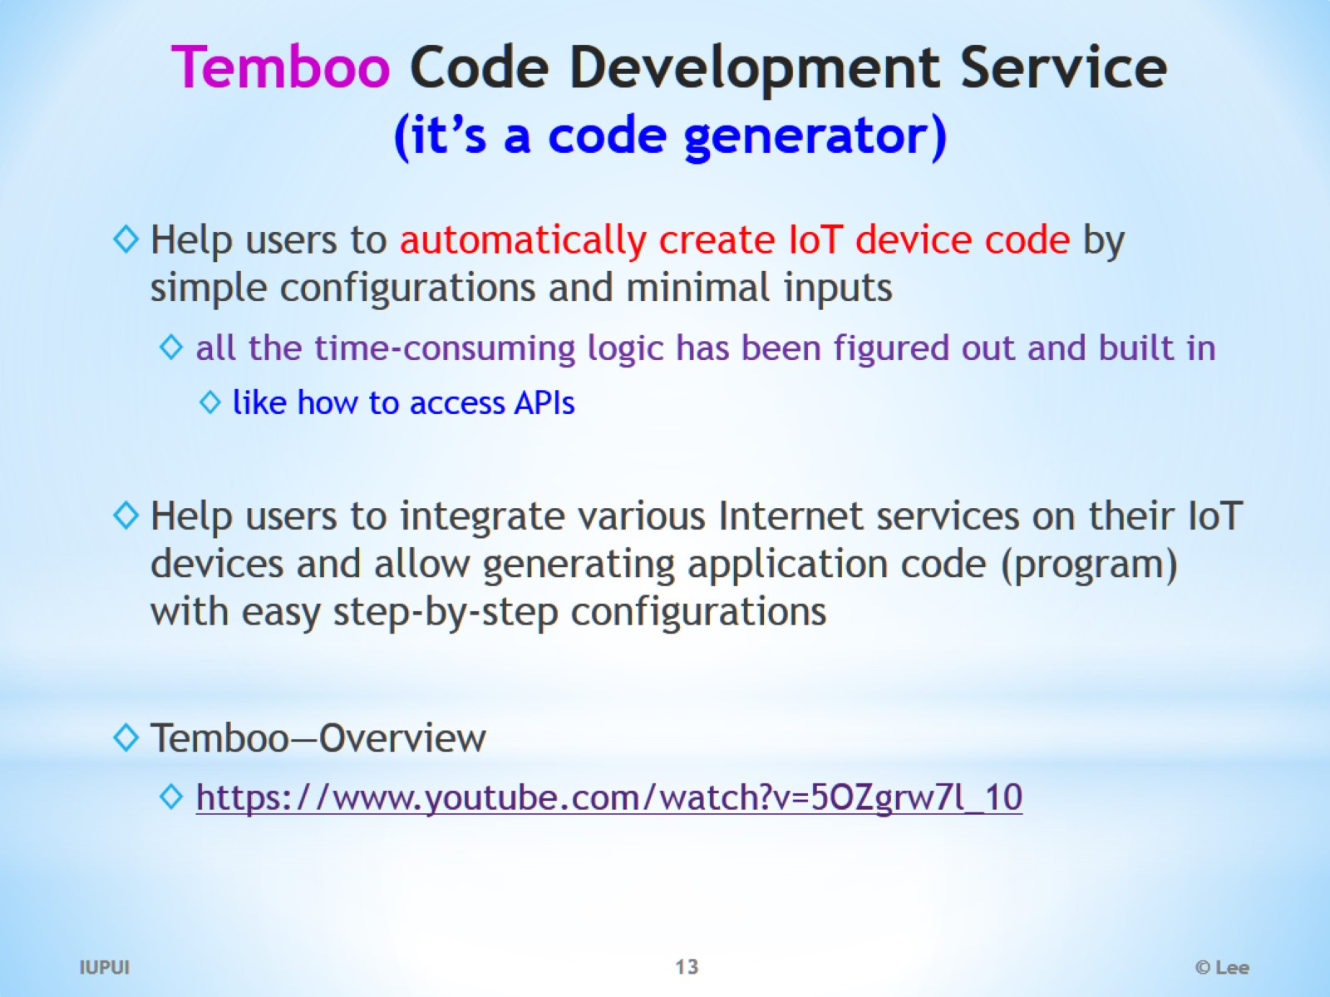
Temboo Code Development Service (it’s a code generator)

Slide 14
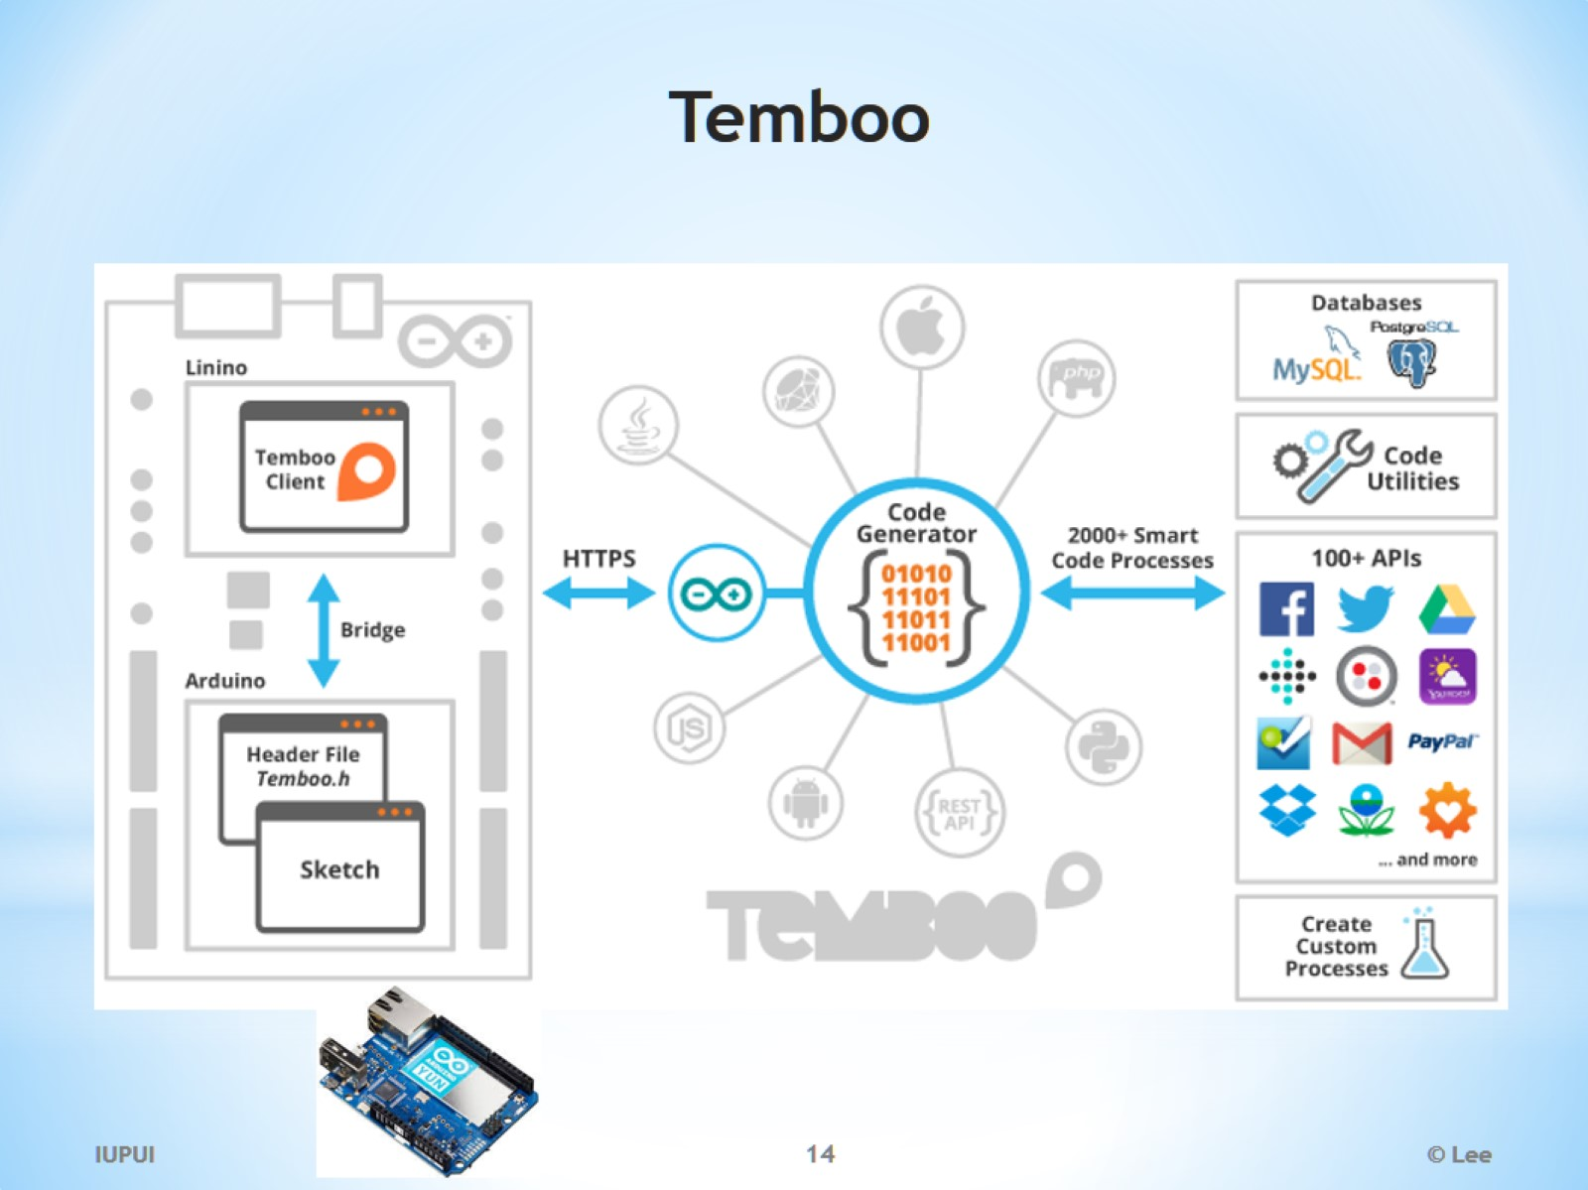
Temboo

Slide 15
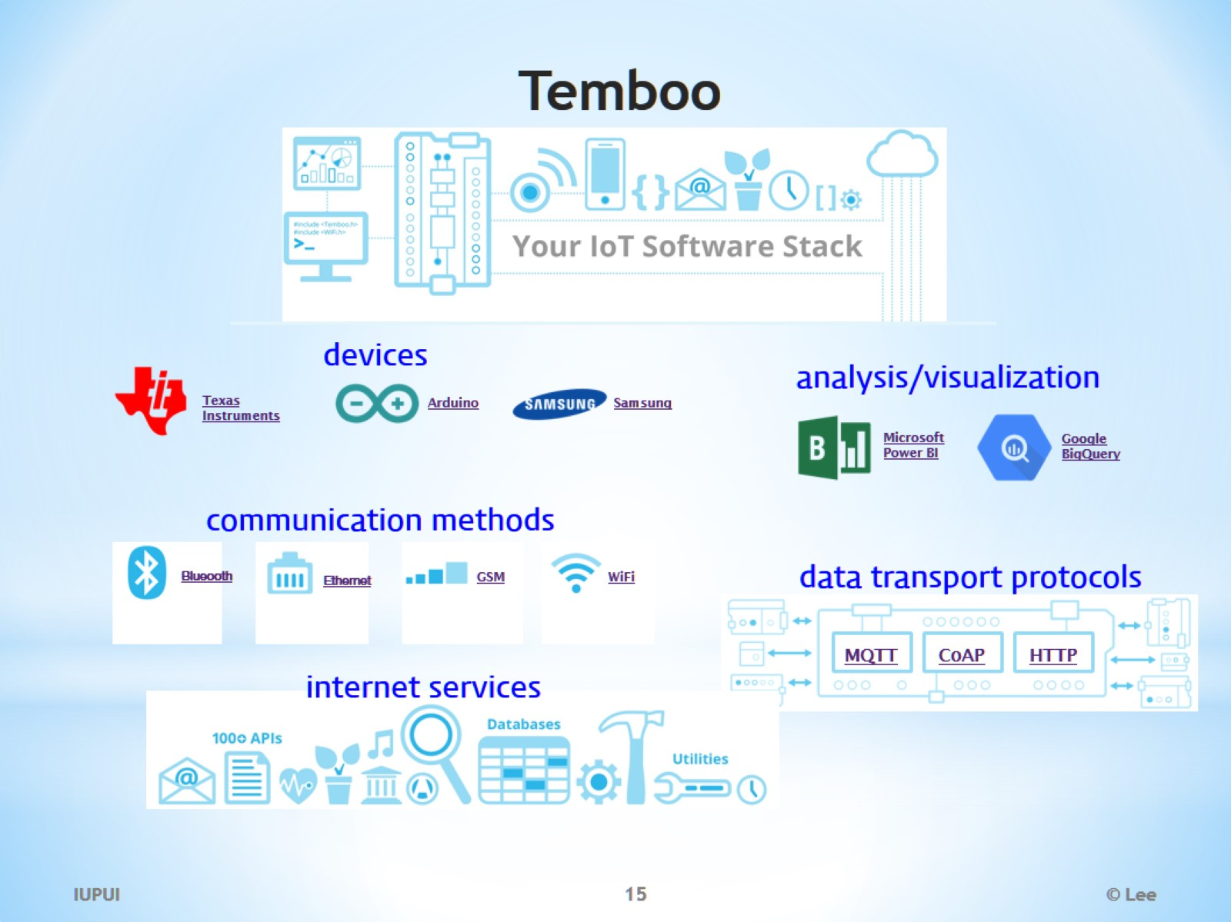
Temboo

Slide 16
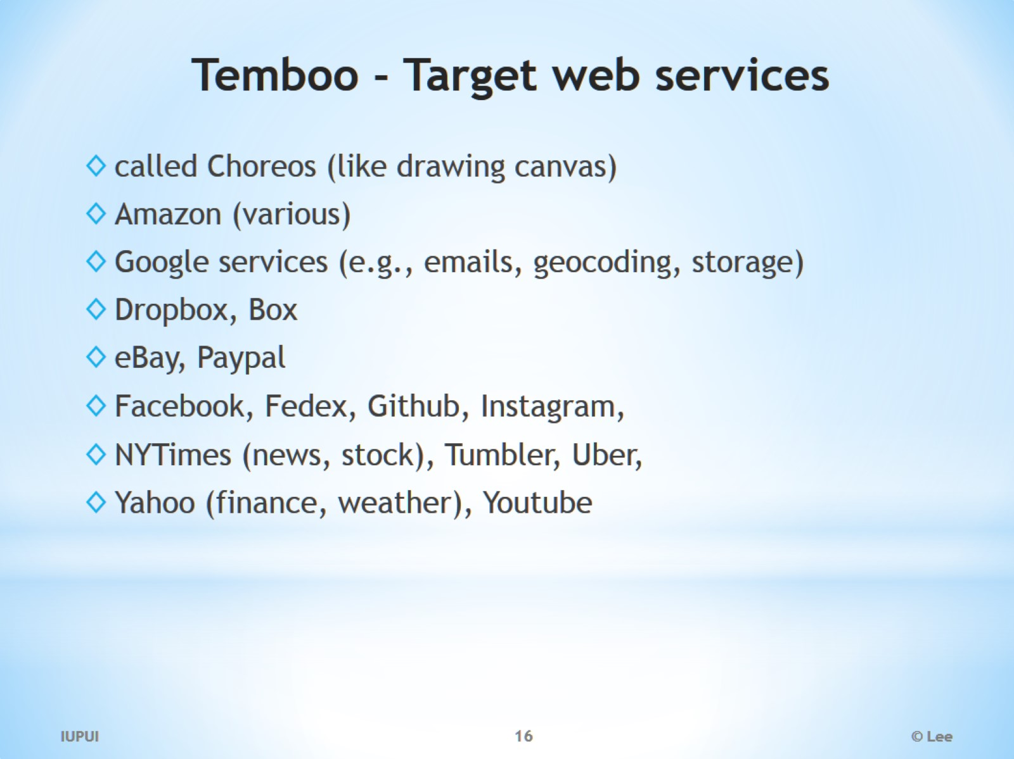
Temboo - Target web services

Slide 17
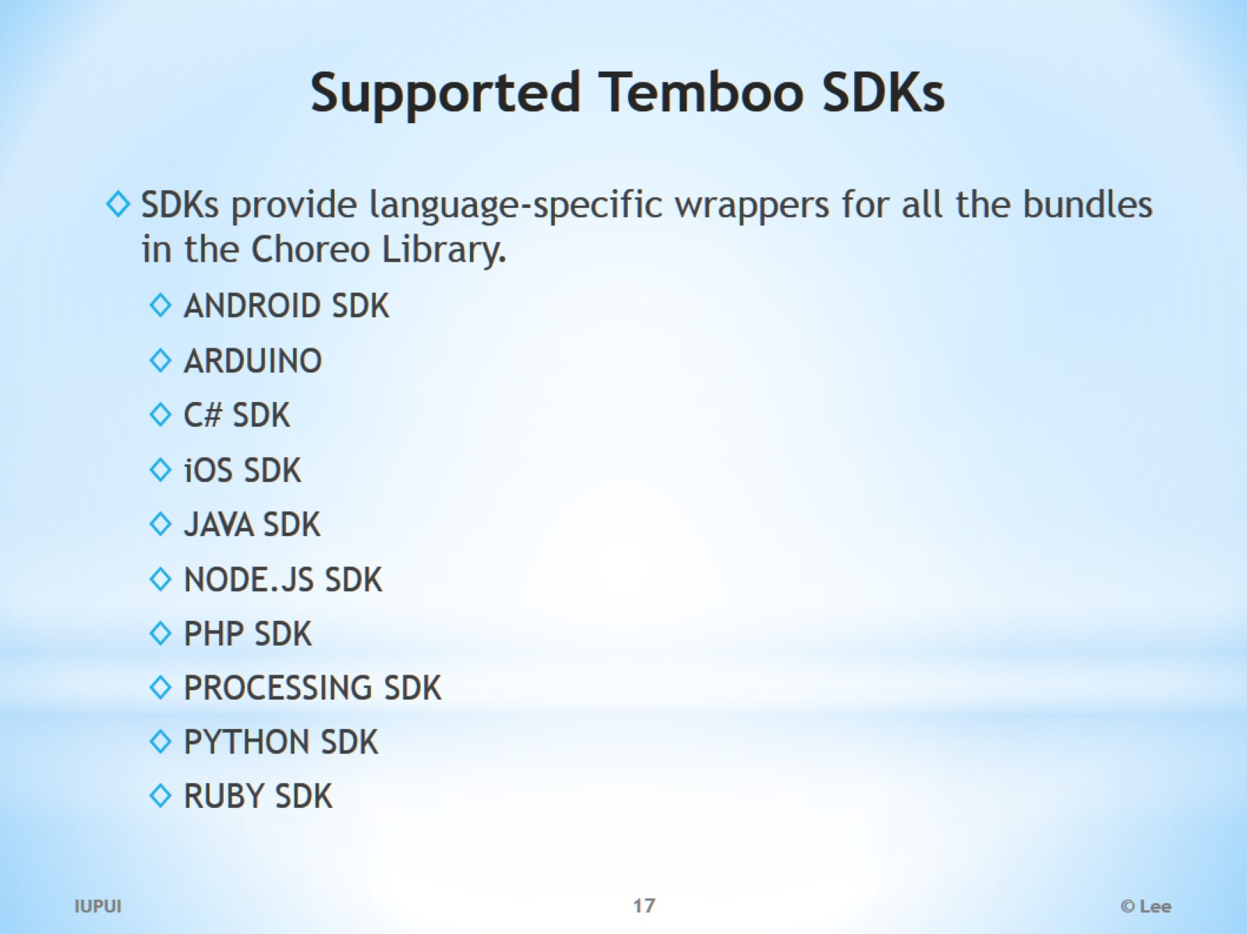
Supported Temboo SDKs

Slide 18
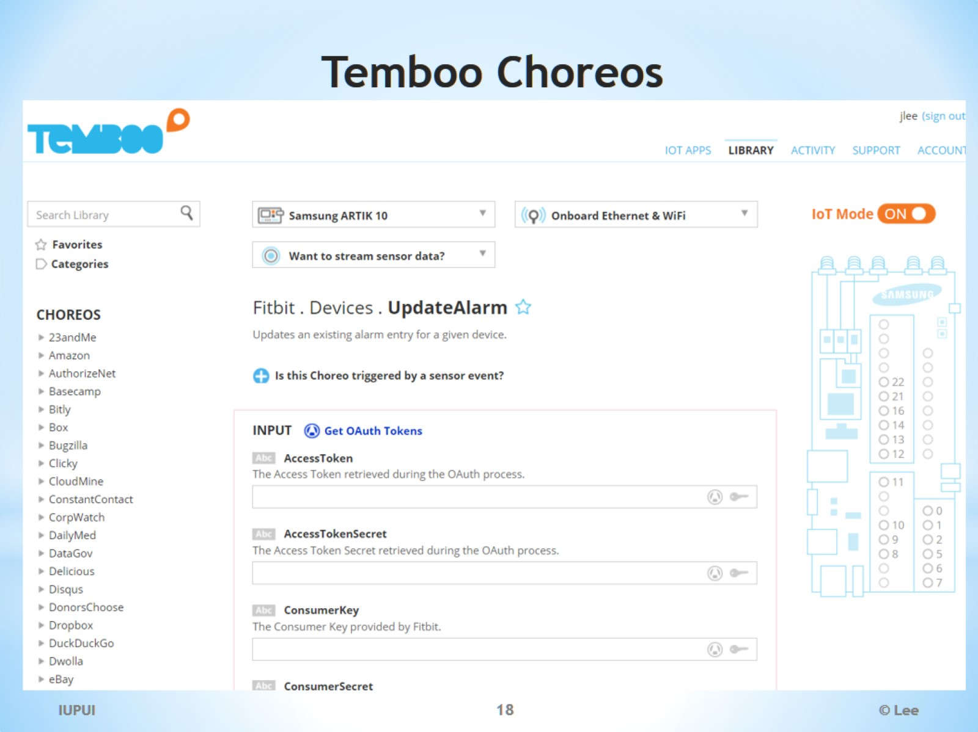
Temboo Choreos

